Slide 1
Sentiments in Twitter
Kaneesha Dawood

Slide 2
The problem
Company
Context
Problem statement
Tweets come from a variety of sources (consumers, companies, public officials etc). Consumers use Twitter to connect to their brand. Likewise, their sentiments are an invaluable asset to the company.
Twitter is one of the popular micro-blogging platforms that provide data for a wide range of users.
“How can a company use Twitter sentiments to predict consumer spending patterns?”

Slide 3
Problem Identification & Approach
Goal: Identify the positive and negative sentiments in making a purchasing decision.
Approach
Read the Twitter Data
Data Exploration
Data Cleaning and Preprocessing
Exploratory Analysis and Visualization
Feature Extraction
Model Building and Evaluation

Slide 4
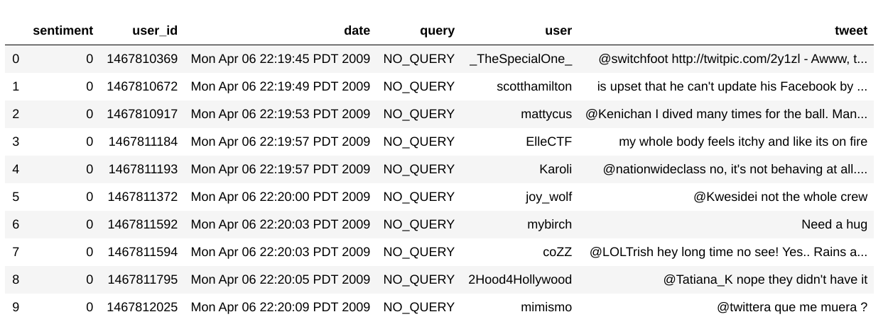
Twitter Dataset

Slide 5
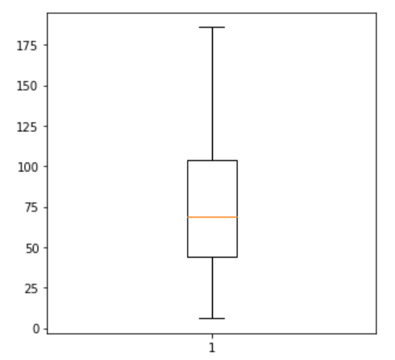
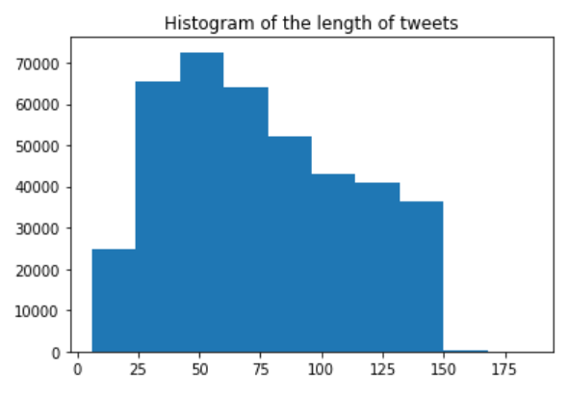
Univariate Analysis

Slide 6
Data Preprocessing and Cleaning
The raw Twitter text include people's casual opinions in the form of informal language which add noise to our data.
Steps to Preprocess:
Drop Columns ‘user_id’, ‘date’, ‘query’, ‘user’
Convert tweet to lower case
Remove punctuation, numbers, and irrelevant characters
Eliminate extra white space
Tokenization
Remove Stop words
Lemmatization
Stemming

Slide 7
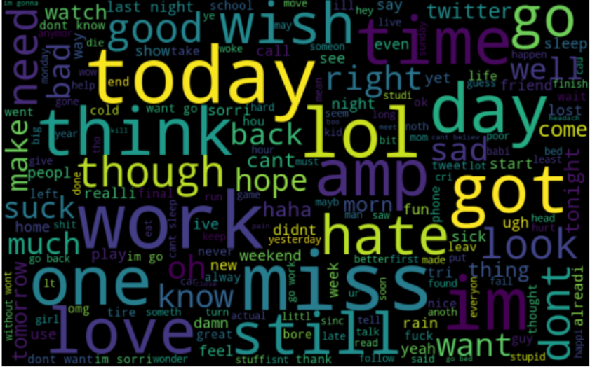

Slide 8
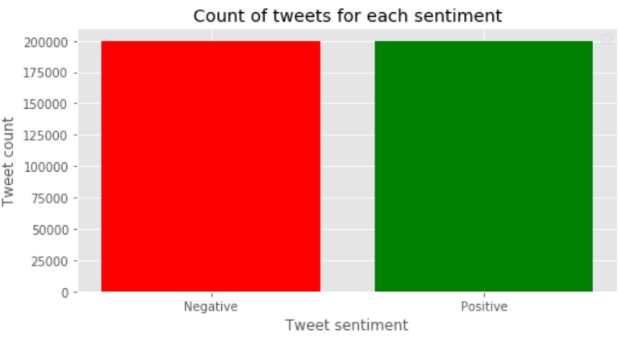
Twitter Sentiments

Slide 9
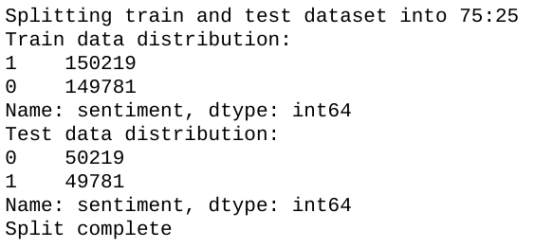
Train-Test Split
Identify the Variables
Y = target variable = sentiment
X = features = tweets
Data is distributed into two sets on a 75:25 ratio
Training set
Testing set

Slide 10
Feature Extraction
I used the following methods to extract words from our clean dataset:
TF-IDF Features (Term Frequency- Inverse Document Frequency):
To identify and extract the most important words
Bag-of-Words Features:
Words are extracted and converted into the binary form

Slide 11
Model Evaluation
 | Random Forest | Logistic Regression | Naive Bayes | Gradient Boosting
Accuracy | 98.983% | 98.744% | 90.273% | 86.737%
F1 Score | 0.99 | 0.99 | 0.91 | 0.88
Notes:
https://github.com/ktdawood/Sentiments-in-Twitter

Slide 12
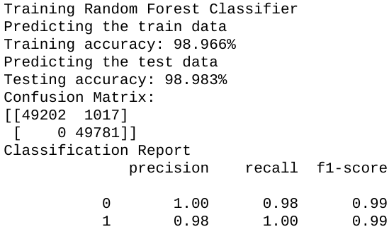
Best Model
The best classifier in predicting the Twitter Sentiment is the Random Forest Classifier
Predictive performance: Higher accuracy scores on the Training and Testing data (98%)
Captures both positive and negative words and predicts the outcome of the future Twitter Sentiment
Reliable feature importance estimate

Slide 13
Conclusion
My goal was to detect the positive and negative sentiments from the Twitter data to help the company predict their consumer spending patterns.
Preprocessed data using NLP techniques
Extracted features using two methods
Built several models to predict performance
Evaluated models using 2-3 metrics
Best model: Random Forest Classifier

Slide 14
Future Work
Increase the sample size and analyze the impact of model performance
Use advanced Natural Language Processing techniques to classify the text
Build more models and evaluate against different performance metrics
Tune the hyperparameters through cross validation

